Slide 1
W4111 – Introduction to Databases Section 002, Spring 2024 Lecture 2: ER, Relational, SQL (I)
© Donald F. Ferguson, 2024

Slide 2
W4111 – Introduction to Databases Section 002, Spring 2024 Lecture 2: ER, Relational, SQL (I)
We will start in a couple of minutes.
© Donald F. Ferguson, 2024

Slide 3

Contents
3 | COMS W4111_002_2024_1: Lecture 2: ER, Relational, SQL (I) © Donald F. Ferguson, 2024

Slide 4
Contents
Introduction: Status updates
ER (Diagram) Modeling (Chapter 6)
The Relational Model and Algebra (Chapter 2)
SQL (Chapter 3)

Slide 5
Introduction
5 | COMS W4111_002_2024_1: Lecture 2: ER, Relational, SQL (I) © Donald F. Ferguson, 2024

Slide 6
Status Updates
TAs:
The TA’s are on-board, although we may be getting a couple more.
We had a kickoff meeting and begun the work.
The TA will be setting up HW 0 submission, which will be very simple.
The TA’s have started posting OHs on the instructors’ page of the website. (https://donald-f-ferguson.github.io/W4111-Intro-to-Databases-Spring-2024/instructors.html)
HW 0 is due Sunday (28-JAN) at 11:59 PM.
HW 1 come out this weekend.
You will have two weeks.
There will two parts:
Written questions based on material from 1st lecture and slides associated with textbook.
Practical tasks.

Slide 7
Database design, Entity-Relationship Model (Part 1)
7 | COMS W4111_002_2024_1: Lecture 2: ER, Relational, SQL (I) © Donald F. Ferguson, 2024

Slide 8

Concepts (Reminder, Cover Quickly)
8 | COMS W4111_002_2024_1: Lecture 2: ER, Relational, SQL (II) © Donald F. Ferguson, 2024

Slide 9
Design Phases
Initial phase -- characterize fully the data needs of the prospective database users.
Second phase -- choosing a data model
Applying the concepts of the chosen data model
Translating these requirements into a conceptual schema of the database.
A fully developed conceptual schema indicates the functional requirements of the enterprise.
Describe the kinds of operations (or transactions) that will be performed on the data.
DFF Comments:
We you see slides with this formatting, the come directly from the presentations associated with the textbook. (https://www.db-book.com/)
The number at the bottom is of the form chapter.slide_no.
I try to put my comments, modifications and annotations in red text, or inside a red rectangle/callout.

Slide 10
Design Phases (Cont.)
Final Phase -- Moving from an abstract data model to the implementation of the database
Logical Design – Deciding on the database schema. Database design requires that we find a “good” collection of relation schemas.
Business decision – What attributes should we record in the database?
Computer Science decision – What relation schemas should we have and how should the attributes be distributed among the various relation schemas?
Physical Design – Deciding on the physical layout of the database
Notes:
10

Slide 11
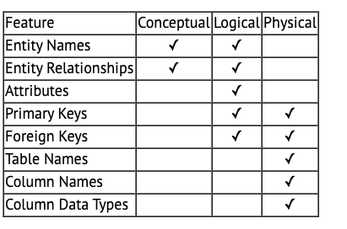
A Common and my Approach: Conceptual → Logical → Physical
https://ehikioya.com/conceptual-logical-physical-database-modeling/
https://www.1keydata.com/datawarehousing/data-modeling-levels.html
It is easy to get carried away with modeling. You can spend all your time modeling and not actually build the schema.
We will use the approaches in class.
Mostly to understand concepts and patterns.
https://www.1keydata.com/datawarehousing/data-modeling-levels.html

Slide 12
ER model -- Database Modeling
The ER data mode was developed to facilitate database design by allowing specification of an enterprise schema that represents the overall logical structure of a database.
The ER data model employs three basic concepts:
entity sets,
relationship sets,
attributes.
The ER model also has an associated diagrammatic representation, the ER diagram, which can express the overall logical structure of a database graphically.

Slide 13
Entity Sets
COMS W4111 002 01 2024
An entity is an object that exists and is distinguishable from other objects.
Example: specific person, company, event, plant
An entity set is a set of entities of the same type that share the same properties.
Example: set of all persons, companies, trees, holidays
An entity is represented by a set of attributes; i.e., descriptive properties possessed by all members of an entity set.
Example:
instructor = (ID, name, salary ) course= (course_id, title, credits)
A subset of the attributes form a primary key of the entity set; i.e., uniquely identifying each member of the set.
DFF Comments:
Some of these statements apply primarily to OO systems and the relational/SQL models.
A motivation for “No SQL” is to relax the constraints.

Slide 14
Entity Sets -- instructor and student

Slide 15
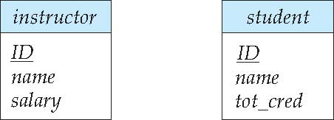
Representing Entity sets in ER Diagram
Entity sets can be represented graphically as follows:
Rectangles represent entity sets.
Attributes listed inside entity rectangle
Underline indicates primary key attributes

Slide 16
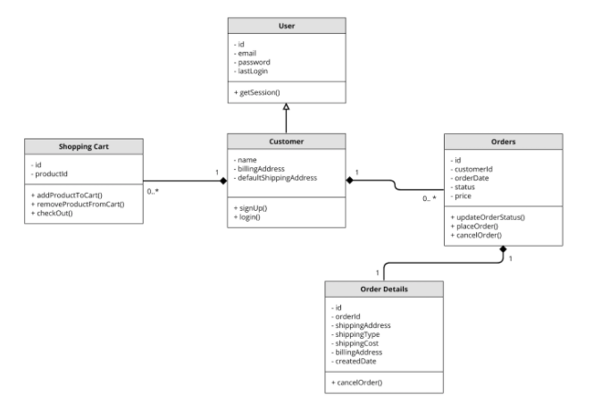
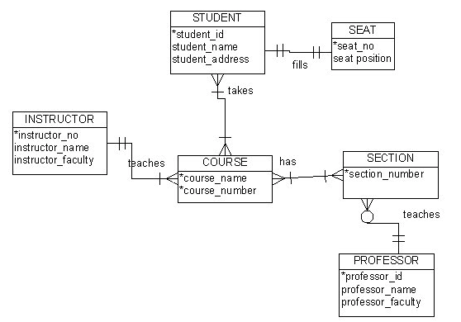
Visual Notation – Many Notations
ER Model
UML
“Other,” i.e. PowerPoint is the most common modeling notation.
It is easy to get “carried away.”
The trick is to do “just enough modeling.”
I mostly use Crow’s Foot
It is “just enough”
But lacks some capabilities.
The book uses ER notation.
Crow’s Foot

Slide 18
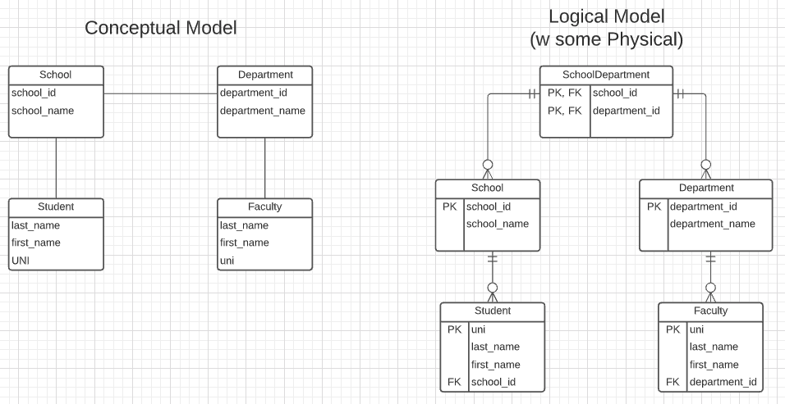
First Iteration/Step for University Data Model
This is the level of detail I want when I ask for:
Conceptual Model diagram.
Logical Model diagram.
Some online tools with “free,” constrained usage.
Lucidchart (https://www.lucidchart.com/)
Vertabelo (https://vertabelo.com/)
The model has:
Four entity sets: School, Department, Student, Faculty
Three relationship sets: Student-School, School-Department, Faculty-Department.

Slide 19
Entity Sets -- instructor and student
(45565, 00128)
(98345, 98988)
DFF Comments: Just a reminder of a previous slide.

Slide 20
Relationship Sets
A relationship is an association among several entities
Example: 44553 (Peltier) advisor 22222 (Einstein) student entity relationship set instructor entity
A relationship set is a mathematical relation among n ≥ 2 entities, each taken from entity sets
{(e₁, e₂, … e_{n}) | e₁ ∈ E₁, e₂ ∈ E₂, …, e_{n} ∈ E_{n}} where (e₁, e₂, …, e_{n}) is a relationship
Example:
(44553,22222) ∈ advisor
DFF Comments:
Nobody thinks about relationships this way.
There is no idea so simple that a DB professor cannot make it confusing, usually by using math.

Slide 21
{(e₁, e₂) | e₁ ∈ instructor, e₂ ∈ students}
Instructor | Student
76766 | 98988
45565 | 12345
45565 | 00128
Student
dff9
Professor yy5
Thesis 1234
(dff9, yy5, 1234)

Slide 22
Relationship Sets (Cont.)
Example: we define the relationship set advisor to denote the associations between students and the instructors who act as their advisors.
Pictorially, we draw a line between related entities.
Faculty | Student
76766 | 98988
45565 | 12345
45565 | 00128
DFF Comments:
Nobody draws the diagrams this way, but ...
Sometimes thinking this way helps understand other ways to depict the concept.
(dff9, W4111)

Slide 23
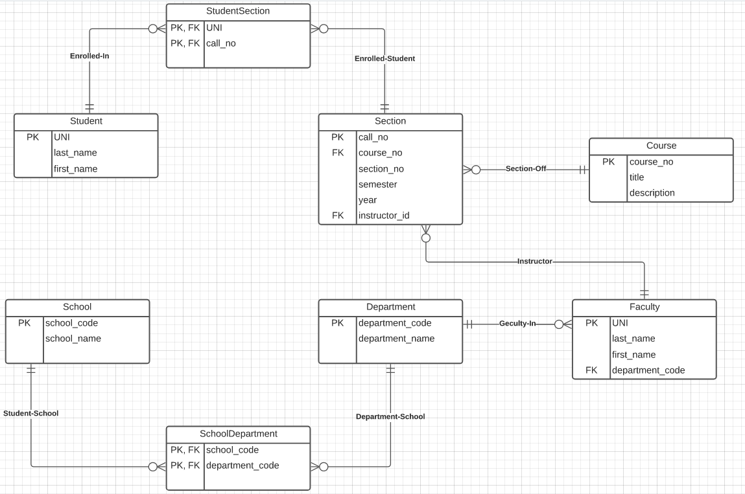
Notation has Precise Meaning
UNI | CALLNO
dff9 | 006135
dff9 | 110234
yy5 | 006153
Attribute annotations:
PK = Primary Key
FK = Foreign Key
Line annotations:
We will learn over time and there are good tutorials (https://www.lucidchart.com/pages/er-diagrams) to help study and refresh.
We will spend a lot of time discussing keys.
We will start in a couple of slides.

Slide 24
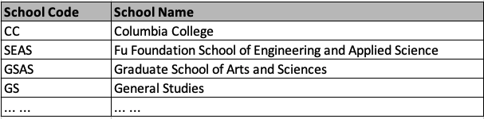

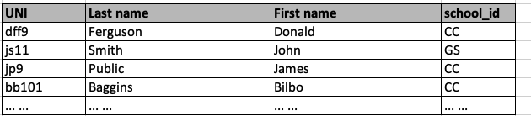
What Does this Mean? Let’s Get Started
Primary Key means that the value occurs at most once.
Student.school_id references school.school_code
Foreign Key means that if a value occurs in school_id for any row, there must be a row in School with that key.
The line notations mean:
A student is related to EXACTLY ONE school.
A School may be related to 0, 1 or many students.

Slide 25
ER model -- Database Modeling
The ER data mode was developed to facilitate database design by allowing specification of an enterprise schema that represents the overall logical structure of a database.
The ER data model employs three basic concepts:
entity sets,
relationship sets,
attributes.
The ER model also has an associated diagrammatic representation, the ER diagram, which can express the overall logical structure of a database graphically.
DFF Comments:
The book and slides do not do a great job of motivating the ER model or ER diagrams.
Why do people and teams think about or use the ER model and modeling?

Slide 26

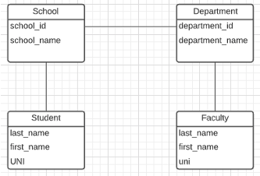
ER Model and ER Modeling
ER Model
Generalization
ER Model: Agility, Separation of Concerns
ER model is a generalization that most DB models implement in some form.
Using the ER model enables:
Thinking about and collaborating on design with getting bogged down in details.
Enable flexible choices about how to realize/Implement data.
ER Diagrams: Communication, Quality, Precision
With a little experience, everyone can understand and ER diagram.
Easier to discuss and collaborate on application’s data than showing SQL table definitions, JSON, ... ...
People think visually. That is why we have whiteboards. ER diagrams are precise and unambiguous.
Guides you to think about relationships, keys, ... And prevents “re-dos” later in the process. It is easier to fix a diagram than a database schema.
Specialization
Relational
Doc Model
Graph Model
... ...
UI UX
Business Professional
Business Service Developer
DB Pros

Slide 27
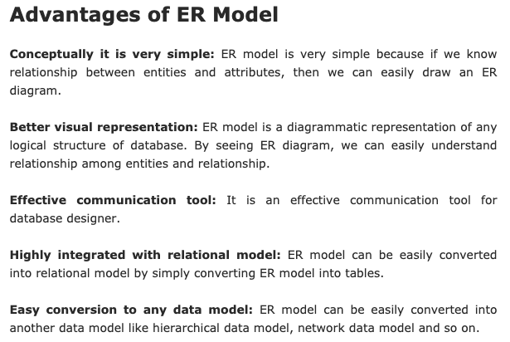
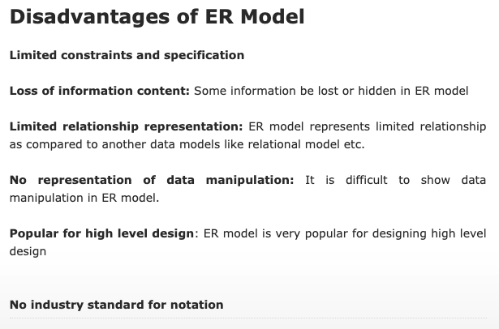
ER Modeling – Reasonably Good Summary
https://pctechnicalpro.blogspot.com/2017/04/advantages-disadvantages-er-model-dbms.html
Note:
If you get to use Google to help with take home exams, HW, etc.
I get to use Google to help with slides.

Slide 28
Apply to –
Game of Thrones/IMDB University Data Model
~/Dropbox/00NewProjects/CU-Course-Example/game-of-thrones/data
28 | COMS W4111_002_2024_1: Lecture 2: ER, Relational, SQL (II) © Donald F. Ferguson, 2024

Slide 29
Game of Thrones
Bottom-Up Data Mapping:
“Nouns” usually map to Entity/Entity Set.
Nouns inside other nouns often map to:
Attribute
Relationship
Verbs often map to relationships.
Adjectives usually map to properties.
We will start with a subset of the information:
Game of Thrones:
Episodes
Characters
IMDB:
names_basics
title_basics
Entities Sets
Character
Season
Episode
Scene
Location, Sublocation
... ...
Relationships
Character – Scene
Character – Character (e.g. KilledBy)
Season – IMDB Title
Character – IMDB Name
... ...

Slide 30
Game of Thrones
Bottom-Up Data Mapping:
“Nouns” usually map to Entity/Entity Set.
Nouns inside other nouns often map to:
Attribute
Relationship
Verbs often map to relationships.
Adjectives usually map to properties.
We will start with a subset of the information:
Game of Thrones:
Episodes
Characters
IMDB:
names_basics
title_basics
Entities Sets
Character
Season
Episode
Scene
Location, Sublocation
... ...
Relationships
Character – Scene
Character – Character (e.g. KilledBy)
Season – IMDB Title
Character – IMDB Name
... ...
IMDB: https://developer.imdb.com/non-commercial-datasets/
Do not download.
Despite being “tiny” compared to the reall world.
The datasets are too big for most laptops.
Game of Thrones: https://github.com/jeffreylancaster/game-of-thrones

Slide 31
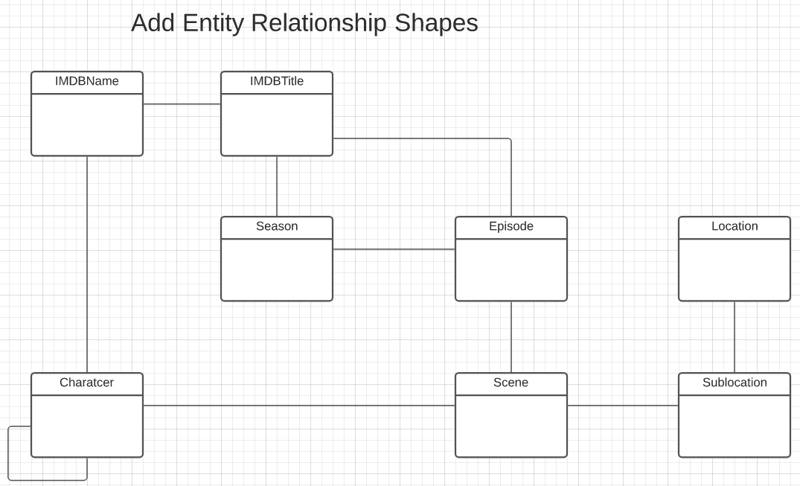
Game of Thrones – Conceptual Model
Add shapes in Lucidchart ...
With a little
Data exploration
Common sense
Judgment/experience
I came to this conceptual model.
Attributes unspecified
Relationship required/cardinality unspecified.
A little more exploration is needed.

Slide 32
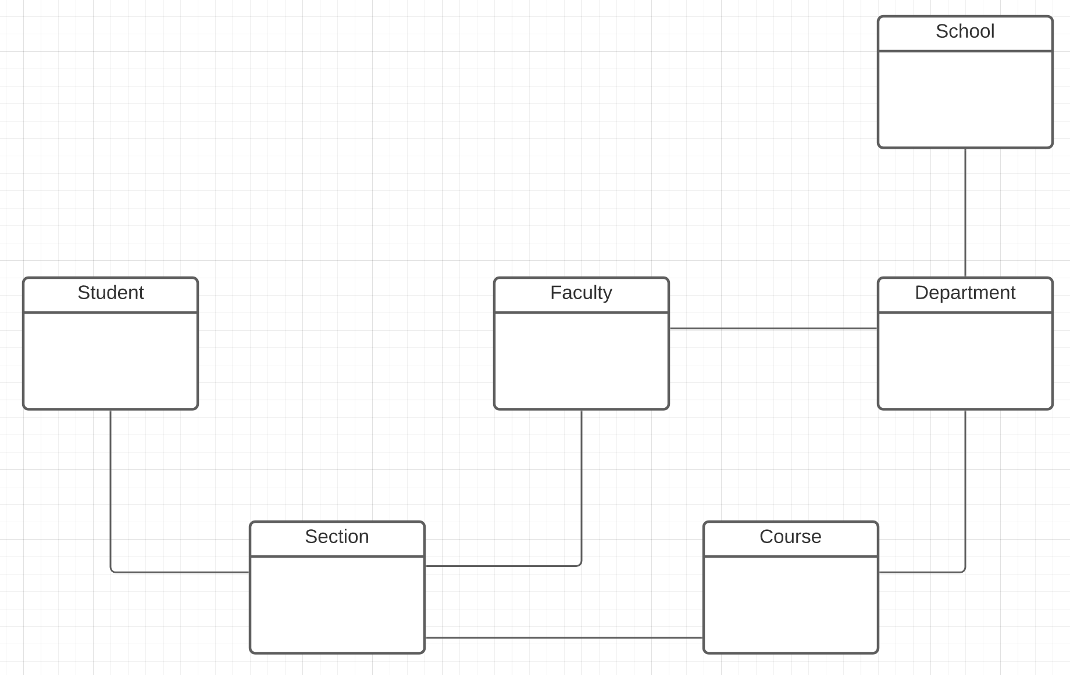
Columbia University – Conceptual Model
A good first pass at a subset of entity types is:
Student
Faculty
Class
Section
Department
School
And there are some obvious relationships

Slide 33
Conceptual to Logical
https://www.1keydata.com/datawarehousing/data-modeling-levels.html
The preceding material provided a conceptual model for a question on HW1
HW 1 requests a logical model. We must add:
Attributes
Primary Keys
Foreign Keys
HW 1 reinforces logical modeling concepts:
It is not trying to accurately model a university data model.
Do not worry about perfect semantics.
Just show you understand the concepts.
To understand logical models, let’s look at the Lahman’s Baseball DB.
https://www.1keydata.com/datawarehousing/data-modeling-levels.html

Slide 34
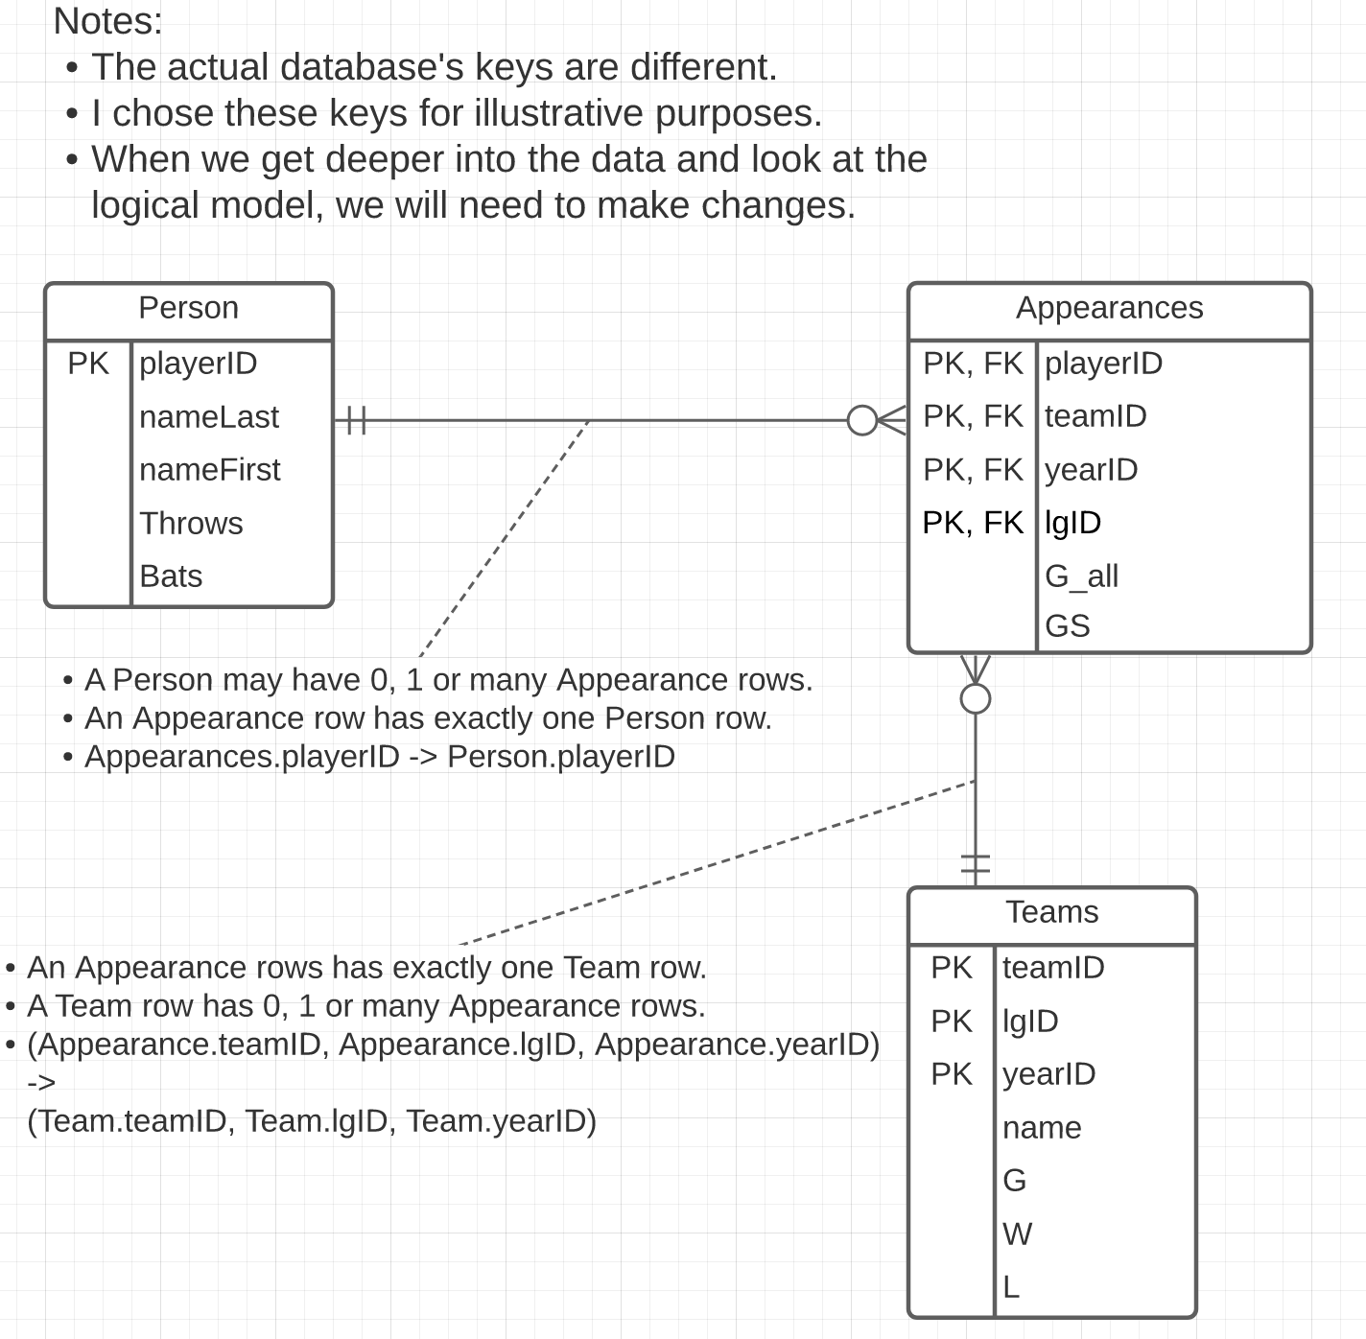
Lahman’s Baseball DB (You will also use)
Some core entity types are:
Person
Team
Appearances
The relationship is simple:
Person – Appearance
Appearance – Team
We will only do a subset of the attributes.
Switch to Notebook and run queries.
https://www.seanlahman.com/baseball-archive/

Slide 35
Some Interesting Queries
A super key “test:”
select playerID, teamID, lgID, yearID, count(*) as count from appearances group by playerID, teamID, yearID order by count desc limit 10;
A candidate key “test:”
select playerID, teamID, yearID, count(*) as count from appearances group by playerID, teamID, yearID order by count desc limit 10;
A foreign key ”test:”
select * from appearances where playerID not in (select playerID from people)
select * from appearances where not exists (select * from teams where appearances.teamID=teams.teamID and appearances.yearID=teams.yearID and appearances.lgID=teams.lgID)

Slide 36
Ideas
Candidate Key
Unique
Minimal number of columns
(UNI)
Super Key
(UNI, last_name)
Student
Student_ID
UNI
Email Unique (never same one twice. But I may not know → NULL)

Slide 37
(dff9, Ferguson, Donald, dff@cs.columbia.edu)
(dff9, Ferguson, Donald, …)
(dff9, Ferguson, Douglas, …)
(uni, last_name) → Super Key
(uni) → Super Key
Candidate is a minimal super key
(uni)
(email)
Primary is arbitrarily chosen candidate key: UNI
Super Key
Candidate Key
Primary Key

Slide 38
Used Lucidchart to show top-down modeling for a university or IMDB, GoT
38 | COMS W4111_002_2024_1: Lecture 2: ER, Relational, SQL (II) © Donald F. Ferguson, 2024

Slide 39
Relation Model and Algebra
39 | COMS W4111_002_2024_1: Lecture 2: ER, Relational, SQL (I) © Donald F. Ferguson, 2024

Slide 40
Schema Definition
40 | COMS W4111_002_2024_1: Lecture 2: ER, Relational, SQL (II) © Donald F. Ferguson, 2024

Slide 41
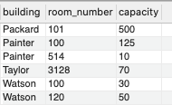
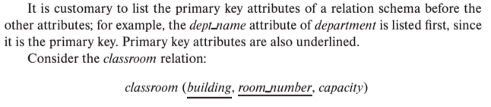
Notation
Classroom relation
classroom schema
Columns (Attributes)
Relation Name
Primary Key Columns
The primary key is a composite key. Neither column is a key (unique) by itself.
Keys are statements about all possible, valid tuples and not just the ones in the relation.
Capacity is unique in this specific data, but clearly not unique for all possible data.
In this domain, there cannot be two classrooms with the same building and room number.
Relation schema:
Underline indicates a primary key column. There is no standard way to indicate other types of key.
We will use bold to indicate foreign keys.
You will sometimes see things like classroom(building:string, room_number:number, capacity:number)

Slide 42
Some More Relational Algebra and The Dreaded RelaX Calculator
42 | COMS W4111_002_2024_1: Lecture 2: ER, Relational, SQL (II) © Donald F. Ferguson, 2024

Slide 43
Relational Algebra
A procedural language consisting of a set of operations that take one or two relations as input and produce a new relation as their result.
Six basic operators
select: σ
project: ∏
union: ∪ (and intersection)
set difference: –
Cartesian product: x
rename: ρ
← assignment

Slide 44
Z = f(X,Y)
F: R² -> R

Slide 45
Composition of Relational Operations
The result of a relational-algebra operation is relation and therefore of relational-algebra operations can be composed together into a relational-algebra expression.
Consider the query -- Find the names of all instructors in the Physics department.
∏_{name}(σ _{dept_name} _{=“Physics”} (instructor))
Instead of giving the name of a relation as the argument of the projection operation, we give an expression that evaluates to a relation.
Why highlight composition before completing coverage of the operations?
The next core relational operator most people consider is JOIN.
The definition of JOIN relies on operation composition.

Slide 46
Cartesian-Product Operation
The Cartesian-product operation (denoted by X) allows us to combine information from any two relations.
Example: the Cartesian product of the relations instructor and teaches is written as:
instructor X teaches
We construct a tuple of the result out of each possible pair of tuples: one from the instructor relation and one from the teaches relation (see next slide)
Since the instructor ID appears in both relations we distinguish between these attribute by attaching to the attribute the name of the relation from which the attribute originally came.
instructor.ID
teaches.ID
R x R -> R f(x,y)->z

Slide 47
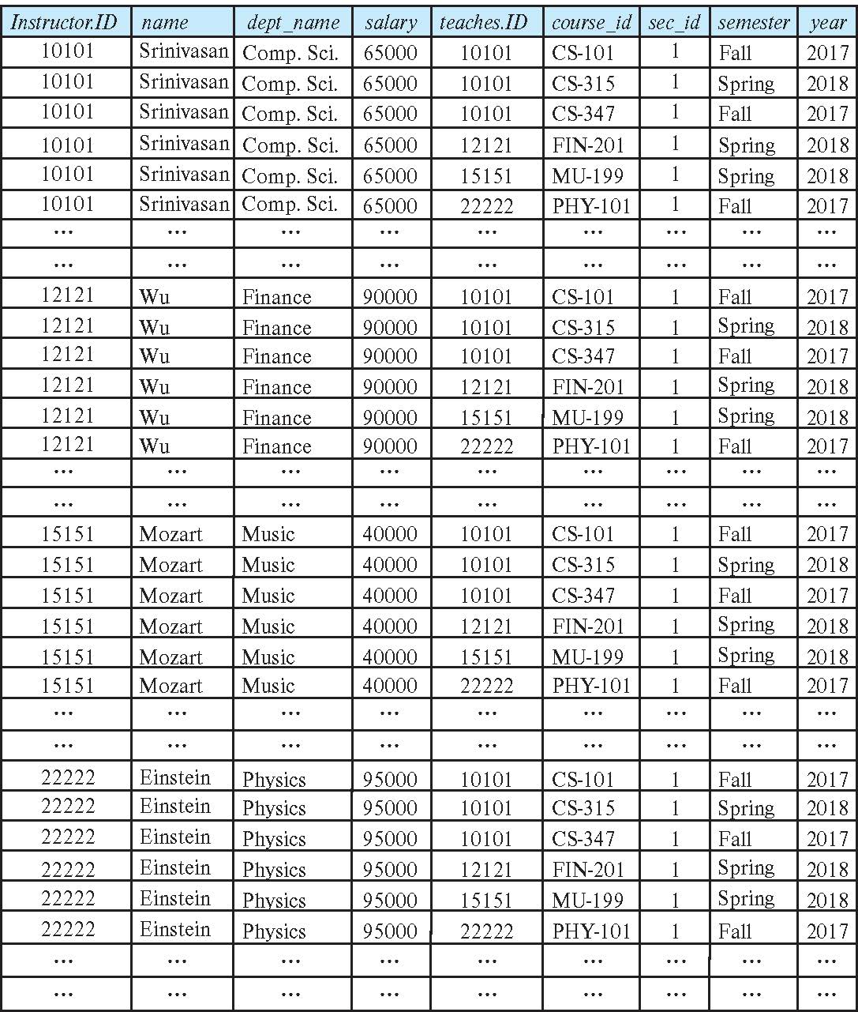
The instructor X teaches table
This only sort of makes sense. The result is:
Every possible combination of the form
(instructor, teaches)
Even if the instructor is NOT the instructor in the teaches row.
Examining in MySQL makes a little clearer.
Let’s look in the lecture examples notebook.
Confusingly, in SQL Cartesian Product is JOIN

Slide 48
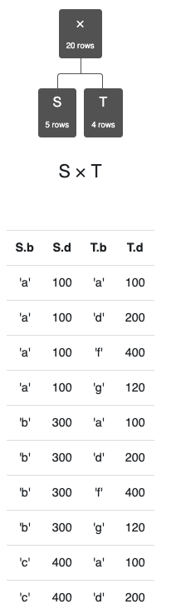
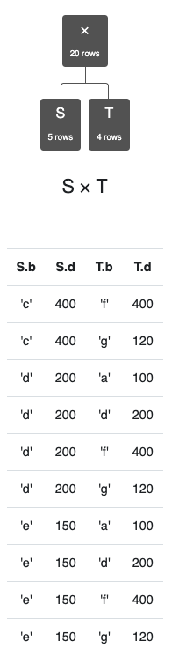
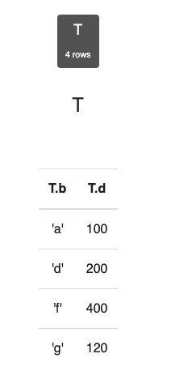
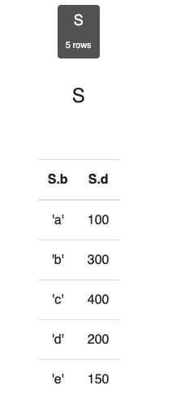
Simpler Example
Assume we have two tables
S has two columns, 5 rows.
T has two columns, 4 rows.
S x T has
4 columns.
20 rows.
Cartesian product does not come up a lot in applications.
There are cases in optimization in which:
You want to generate all possible combinations.
Score, rate, rank etc. to determine best choices.

Slide 49
Join Operation
The Cartesian-Product
instructor X teaches
associates every tuple of instructor with every tuple of teaches.
Most of the resulting rows have information about instructors who did NOT teach a particular course.
To get only those tuples of “instructor X teaches “ that pertain to instructors and the courses that they taught, we write:
σ _{instructor.id = teaches.id} (instructor x teaches ))
We get only those tuples of “instructor X teaches” that pertain to instructors and the courses that they taught.
The result of this expression, shown in the next slide
A fundamental definition:
σ _{instructor.ID=teaches.ID} (instructor ⨯ teaches) = instructor ⨝ teaches
⨝ is the JOIN operations.

Slide 50
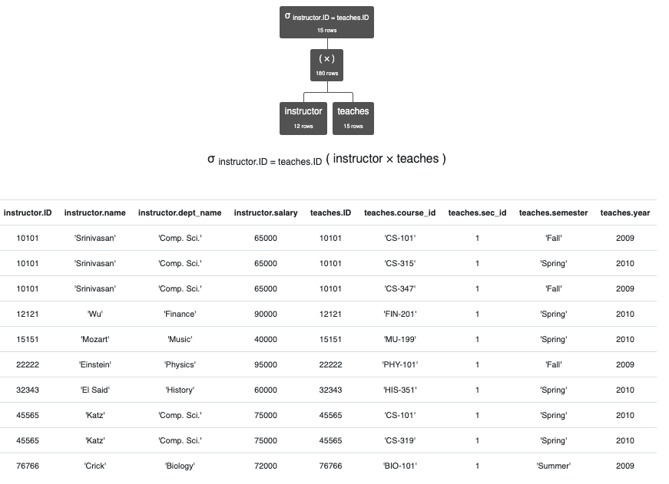
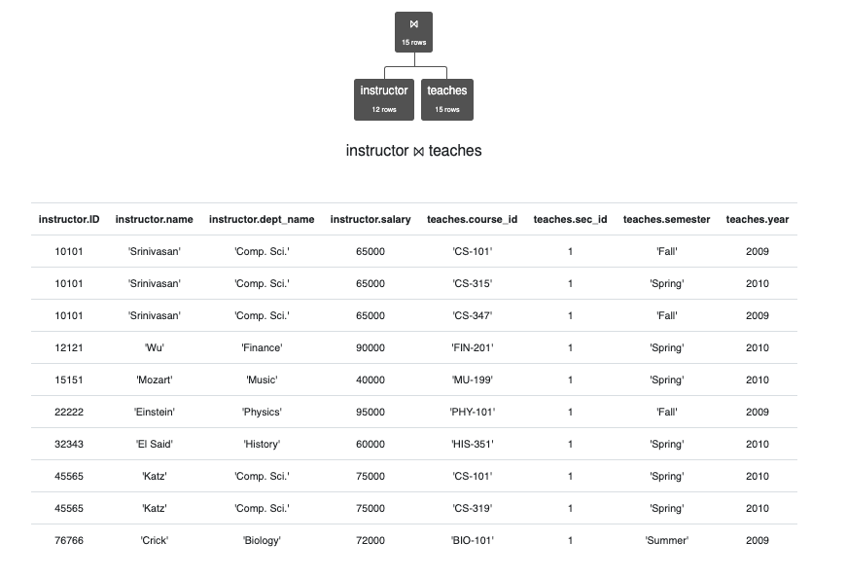
JOIN Definition
σ _{instructor.ID=teaches.ID} (instructor ⨯ teaches)
instructor ⨝ teaches
instructor ⨝ _{instructor.ID>teaches.ID} teaches

Slide 51
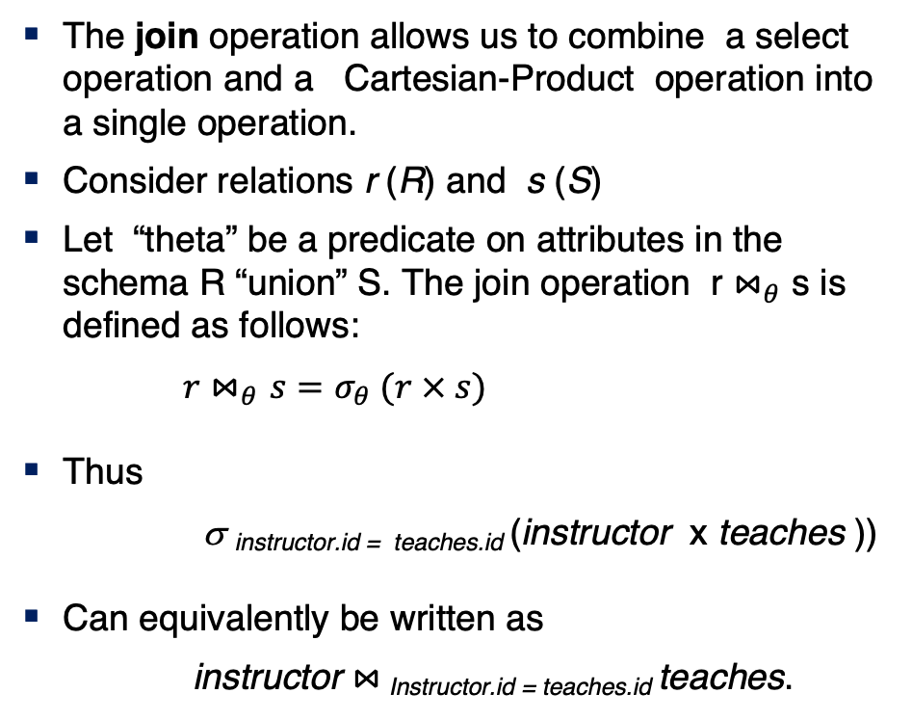
Join Operation (Cont.)
The join operation allows us to combine a select operation and a Cartesian-Product operation into a single operation.
Consider relations r (R) and s (S)
Let “theta” be a predicate on attributes in the schema R “union” S. The join operation r $⋈_{θ}$ s is defined as follows:
$r⋈_{θ}s=σ_{θ} (r × s)$
Thus
σ _{instructor.id = teaches.id} (instructor x teaches ))
Can equivalently be written as
instructor $⋈_{ }$_{Instructor.id = teaches.id} teaches.

Slide 52
Union Operation
The union operation allows us to combine two relations
Notation: r ∪ s
For r ∪ s to be valid.
1. r, s must have the same arity (same number of attributes)
2. The attribute domains must be compatible (example: 2nd
column of r deals with the same type of values as does the 2nd column of s)
Example: to find all courses taught in the Fall 2017 semester, or in the Spring 2018 semester, or in both ∏_{course_id} (σ _{semester=“Fall” Λ year=2017} (section)) ∪ ∏_{course_id} (σ _{semester=“Spring” Λ year=2018} (section))
(a,b,c,d)
(x,y)
Project(a,

Slide 53
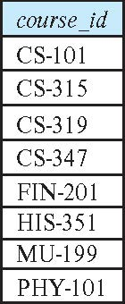
Union Operation (Cont.)
Result of: ∏_{course_id} (σ _{semester=“Fall” Λ year=2017} (section)) ∪ ∏_{course_id} (σ _{semester=“Spring” Λ year=2018} (section))
Note: The preloaded dataset on the RelaX calculator is different from the most recent data referenced in the book. It is from a previous edition.

Slide 54
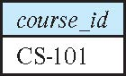
Set-Intersection Operation
The set-intersection operation allows us to find tuples that are in both the input relations.
Notation: r ∩ s
Assume:
r, s have the same arity
attributes of r and s are compatible
Example: Find the set of all courses taught in both the Fall 2017 and the Spring 2018 semesters.
∏_{course_id} (σ _{semester=“Fall” Λ year=2017} (section)) ∩ ∏_{course_id} (σ _{semester=“Spring” Λ year=2018} (section))
Result

Slide 55
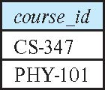
Set Difference Operation
The set-difference operation allows us to find tuples that are in one relation but are not in another.
Notation r – s
Set differences must be taken between compatible relations.
r and s must have the same arity
attribute domains of r and s must be compatible
Example: to find all courses taught in the Fall 2017 semester, but not in the Spring 2018 semester ∏_{course_id} (σ _{semester=“Fall” Λ year=2017} (section)) − ∏_{course_id} (σ _{semester=“Spring” Λ year=2018} (section))

Slide 56
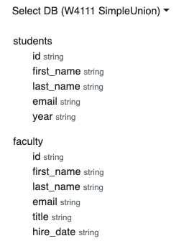
Same “arity”
Same “arity”
Same number of columns.
Compatible types.
The i-th column in each table is from a compatible domain.
Student 5th column is “year.”
Faculty 5th column is “title”
Both are strings but combing them does not make sense.
You can shape two incompatible tables using project operations. For example
π first_name,last_name,email (students) ∩ π first_name,last_name,email (faculty)
π last_name,email, title←'Student' (students) ∪ π last_name,email, title (faculty)

Slide 57
The Assignment Operation
It is convenient at times to write a relational-algebra expression by assigning parts of it to temporary relation variables.
The assignment operation is denoted by ← and works like assignment in a programming language.
Example: Find all instructor in the “Physics” and Music department. Physics ← σ _{dept_name=“Physics”} (instructor)
Music ← σ _{dept_name=“Music”} (instructor)
Physics ∪ Music
With the assignment operation, a query can be written as a sequential program consisting of a series of assignments followed by an expression whose value is displayed as the result of the query.

Slide 58
What are all those other Symbols?
Some of these are pretty obscure
Division
Anti-Join
Left semi-join
Right semi-join
Most SQL engines do not support them.
You can implement them using combinations of JOIN, SELECT, WHERE, ... ...
But, I cannot every remember using them in applications I have developed.
Outer JOIN is very useful, but less common. We will cover.
There are also some “patterns” or “terms”
Equijoin
Non-equi join
Natural join
Theta join
... ...
I may ask you to define these terms on some exams because they may be common internships/job interview questions.
τ order by
γ group by
¬ negation
÷ set division
⨝ natural join, theta-join
⟕ left outer join
⟖ right outer join
⟗ full outer join
⋉ left semi join
⋊ right semi join
▷ anti-join

Slide 59
Some Terms
“A NATURAL JOIN is a JOIN operation that creates an implicit join clause for you based on the common columns in the two tables being joined. Common columns are columns that have the same name in both tables.” (https://docs.oracle.com/javadb/10.8.3.0/ref/rrefsqljnaturaljoin.html)
⨝ ➔ Natural Join in relational algebra.
So, think about it …
I showed you how to produce all possible pairs.
I showed you how to produce all naturally matching pairs.
Some simple set operations gives the anti-join.

Slide 60
SQL
60 | COMS W4111_002_2024_1: Lecture 2: ER, Relational, SQL (I) © Donald F. Ferguson, 2024

Slide 61
Core Concepts and Operations
61 | COMS W4111_002_2024_1: Lecture 2: ER, Relational, SQL (I) © Donald F. Ferguson, 2024

Slide 62
Chapter 3: Introduction to SQL
You can think of SQL being an extended, usable, useful version of the relational model.

Slide 63
Outline
Overview of The SQL Query Language
SQL Data Definition
Basic Query Structure of SQL Queries
Additional Basic Operations
Set Operations
Null Values
Aggregate Functions
Nested Subqueries
Modification of the Database
Will cover in next lecture and/or tutorial.
Notes:
1

Slide 64
History
IBM Sequel language developed as part of System R project at the IBM San Jose Research Laboratory
Renamed Structured Query Language (SQL)
ANSI and ISO standard SQL:
SQL-86
SQL-89
SQL-92
SQL:1999 (language name became Y2K compliant!)
SQL:2003
Commercial systems offer most, if not all, SQL-92 features, plus varying feature sets from later standards and special proprietary features.
Not all examples here may work on your particular system.

Slide 65
SQL Parts
DML -- provides the ability to query information from the database and to insert tuples into, delete tuples from, and modify tuples in the database.
integrity – the DDL includes commands for specifying integrity constraints.
View definition -- The DDL includes commands for defining views.
Transaction control –includes commands for specifying the beginning and ending of transactions.
Embedded SQL and dynamic SQL -- define how SQL statements can be embedded within general-purpose programming languages.
Authorization – includes commands for specifying access rights to relations and views.
Data Definition Language (DDL)
Data Manipulation Language (DML)

Slide 66
Data Definition Language
The SQL data-definition language (DDL) allows the specification of information about relations, including:
The schema for each relation.
The type of values associated with each attribute.
The Integrity constraints
The set of indices to be maintained for each relation.
Security and authorization information for each relation.
The physical storage structure of each relation on disk.

Slide 67
Domain Types in SQL
char(n). Fixed length character string, with user-specified length n.
varchar(n). Variable length character strings, with user-specified maximum length n.
int. Integer (a finite subset of the integers that is machine-dependent).
smallint. Small integer (a machine-dependent subset of the integer domain type).
numeric(p,d). Fixed point number, with user-specified precision of p digits, with d digits to the right of decimal point. (ex., numeric(3,1), allows 44.5 to be stores exactly, but not 444.5 or 0.32)
real, double precision. Floating point and double-precision floating point numbers, with machine-dependent precision.
float(n). Floating point number, with user-specified precision of at least n digits.
More are covered in Chapter 4.

Slide 68
Create Table Construct
An SQL relation is defined using the create table command:
create table r
(A₁ D₁, A₂ D₂, ..., A_{n} D_{n}, (integrity-constraint₁), ..., (integrity-constraint_{k}))
r is the name of the relation
each A_{i} is an attribute name in the schema of relation r
D_{i} is the data type of values in the domain of attribute A_{i}
Example:
create table instructor ( ID char(5), name varchar(20), dept_name varchar(20), salary numeric(8,2))
Note to DFF:
Show performing tasks for new schema in dataGrip.

Slide 69
Integrity Constraints in Create Table
Types of integrity constraints
primary key (A₁, ..., A_{n} )
foreign key (A_{m}, ..., A_{n} ) references r
not null
SQL prevents any update to the database that violates an integrity constraint.
Example:
create table instructor ( ID char(5), name varchar(20) not null, dept_name varchar(20), salary numeric(8,2), primary key (ID), foreign key (dept_name) references department);

Slide 70
And a Few More Relation Definitions
create table student ( ID varchar(5), name varchar(20) not null, dept_name varchar(20), tot_cred numeric(3,0), primary key (ID),
foreign key (dept_name) references department);
create table takes ( ID varchar(5), course_id varchar(8), sec_id varchar(8), semester varchar(6), year numeric(4,0), grade varchar(2),
primary key (ID, course_id, sec_id, semester, year) ,
foreign key (ID) references student, foreign key (course_id, sec_id, semester, year) references section);

Slide 71
And more still
create table course ( course_id varchar(8), title varchar(50), dept_name varchar(20), credits numeric(2,0),
primary key (course_id),
foreign key (dept_name) references department);

Slide 72
Updates to tables
Insert
insert into instructor values ('10211', 'Smith', 'Biology', 66000);
Delete
Remove all tuples from the student relation
delete from student
Drop Table
drop table r
Alter
alter table r add A D
where A is the name of the attribute to be added to relation r and D is the domain of A.
All exiting tuples in the relation are assigned null as the value for the new attribute.
alter table r drop A
where A is the name of an attribute of relation r
Dropping of attributes not supported by many databases.

Slide 73
Basic Query Structure
A typical SQL query has the form: select A₁, A₂, ..., A_{n} from r₁, r₂, ..., r_{m} where P
A_{i} represents an attribute
R_{i} represents a relation
P is a predicate.
The result of an SQL query is a relation.
Note:
The SELECT ... FROM ... WHERE ... Combines two relational operators, σ and ∏.
Actually, it also combines other operators, e.g. x
Notes:
2

Slide 74
The select Clause
The select clause lists the attributes desired in the result of a query
corresponds to the projection operation of the relational algebra
Example: find the names of all instructors: select name from instructor
NOTE: SQL names are case insensitive (i.e., you may use upper- or lower-case letters.)
E.g., Name ≡ NAME ≡ name
Some people use upper case wherever we use bold font.
Notes:
3

Slide 75
The select Clause (Cont.)
SQL allows duplicates in relations as well as in query results.
To force the elimination of duplicates, insert the keyword distinct after select.
Find the department names of all instructors, and remove duplicates
select distinct dept_name from instructor
The keyword all specifies that duplicates should not be removed.
select all dept_name from instructor
Notes:
4

Slide 76
The select Clause (Cont.)
An asterisk in the select clause denotes “all attributes”
select * from instructor
An attribute can be a literal with no from clause
select '437'
Results is a table with one column and a single row with value “437”
Can give the column a name using:
select '437' as FOO
An attribute can be a literal with from clause
select 'A' from instructor
Result is a table with one column and N rows (number of tuples in the instructors table), each row with value “A”
Notes:
5

Slide 77
The select Clause (Cont.)
The select clause can contain arithmetic expressions involving the operation, +, –, ∗, and /, and operating on constants or attributes of tuples.
The query:
select ID, name, salary/12 from instructor
would return a relation that is the same as the instructor relation, except that the value of the attribute salary is divided by 12.
Can rename “salary/12” using the as clause:
select ID, name, salary/12 as monthly_salary
Notes:
5

Slide 78
The where Clause
The where clause specifies conditions that the result must satisfy
Corresponds to the selection predicate of the relational algebra.
To find all instructors in Comp. Sci. dept
select name from instructor where dept_name = 'Comp. Sci.'
SQL allows the use of the logical connectives and, or, and not
The operands of the logical connectives can be expressions involving the comparison operators <, <=, >, >=, =, and <>.
Comparisons can be applied to results of arithmetic expressions
To find all instructors in Comp. Sci. dept with salary > 80000
select name from instructor where dept_name = 'Comp. Sci.' and salary > 80000
Notes:
6

Slide 79
The from Clause
The from clause lists the relations involved in the query
Corresponds to the Cartesian product operation of the relational algebra.
Find the Cartesian product instructor X teaches
select ∗ from instructor, teaches
generates every possible instructor – teaches pair, with all attributes from both relations.
For common attributes (e.g., ID), the attributes in the resulting table are renamed using the relation name (e.g., instructor.ID)
Cartesian product not very useful directly, but useful combined with where-clause condition (selection operation in relational algebra).
Notes:
8

Slide 80
Examples
Find the names of all instructors who have taught some course and the course_id
select name, course_id from instructor , teaches where instructor.ID = teaches.ID
Find the names of all instructors in the Art department who have taught some course and the course_id
select name, course_id from instructor , teaches where instructor.ID = teaches.ID and instructor. dept_name = 'Art'
Notes:
9

Slide 81
The Rename Operation
The SQL allows renaming relations and attributes using the as clause:
old-name as new-name
Find the names of all instructors who have a higher salary than some instructor in 'Comp. Sci'.
select distinct T.name from instructor as T, instructor as S where T.salary > S.salary and S.dept_name = 'Comp. Sci.’
Keyword as is optional and may be omitted instructor as T ≡ instructor T
Notes:
9

Slide 82
Null Values
It is possible for tuples to have a null value, denoted by null, for some of their attributes
null signifies an unknown value or that a value does not exist.
The result of any arithmetic expression involving null is null
Example: 5 + null returns null
The predicate is null can be used to check for null values.
Example: Find all instructors whose salary is null.
select name from instructor where salary is null
The predicate is not null succeeds if the value on which it is applied is not null.
Note:
NULL is an extremely important concept.
You will find it hard to understand for a while.

Slide 83
Null Values (Cont.)
SQL treats as unknown the result of any comparison involving a null value (other than predicates is null and is not null).
Example: 5 < null or null <> null or null = null
The predicate in a where clause can involve Boolean operations (and, or, not); thus the definitions of the Boolean operations need to be extended to deal with the value unknown.
and : (true and unknown) = unknown, (false and unknown) = false, (unknown and unknown) = unknown
or: (unknown or true) = true, (unknown or false) = unknown (unknown or unknown) = unknown
Result of where clause predicate is treated as false if it evaluates to unknown

Slide 84
Modification of the Database
Deletion of tuples from a given relation.
Insertion of new tuples into a given relation
Updating of values in some tuples in a given relation

Slide 85
Deletion
Delete all instructors
delete from instructor
Delete all instructors from the Finance department delete from instructor where dept_name= 'Finance’;
Delete all tuples in the instructor relation for those instructors associated with a department located in the Watson building.
delete from instructor where dept name in (select dept name from department where building = 'Watson');

Slide 86
Deletion (Cont.)
Delete all instructors whose salary is less than the average salary of instructors
Problem: as we delete tuples from instructor, the average salary changes
Solution used in SQL:
First, compute avg (salary) and find all tuples to delete
Next, delete all tuples found above (without recomputing avg or retesting the tuples)
delete from instructor
where salary < (select avg (salary)
from instructor);

Slide 87
Insertion
Add a new tuple to course
insert into course values ('CS-437', 'Database Systems', 'Comp. Sci.', 4);
or equivalently
insert into course (course_id, title, dept_name, credits) values ('CS-437', 'Database Systems', 'Comp. Sci.', 4);
Add a new tuple to student with tot_creds set to null
insert into student values ('3003', 'Green', 'Finance', null);

Slide 88
Insertion (Cont.)
Make each student in the Music department who has earned more than 144 credit hours an instructor in the Music department with a salary of $18,000.
insert into instructor select ID, name, dept_name, 18000 from student where dept_name = 'Music' and total_cred > 144;
The select from where statement is evaluated fully before any of its results are inserted into the relation.
Otherwise queries like
insert into table1 select * from table1
would cause problem

Slide 89
Updates
Give a 5% salary raise to all instructors
update instructor set salary = salary * 1.05
Give a 5% salary raise to those instructors who earn less than 70000 update instructor set salary = salary * 1.05 where salary < 70000;
Give a 5% salary raise to instructors whose salary is less than average
update instructor set salary = salary * 1.05 where salary < (select avg (salary) from instructor);

Slide 90
Updates (Cont.)
Increase salaries of instructors whose salary is over $100,000 by 3%, and all others by a 5%
Write two update statements:
update instructor set salary = salary * 1.03 where salary > 100000; update instructor set salary = salary * 1.05 where salary <= 100000;
The order is important
Can be done better using the case statement (next slide)

Slide 91
Aggregate Functions
91 | COMS W4111_002_2024_1: Lecture 2: ER, Relational, SQL (I) © Donald F. Ferguson, 2024

Slide 92
Aggregate Functions
These functions operate on the multiset of values of a column of a relation, and return a value
avg: average value min: minimum value max: maximum value sum: sum of values count: number of values
Note: Some database implementations have additional aggregate functions.

Slide 93
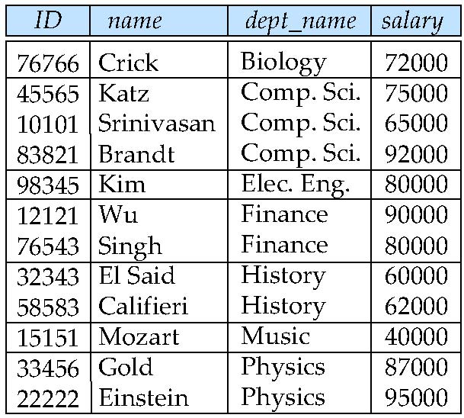
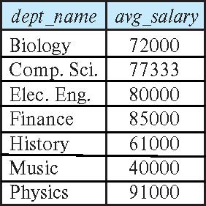
Aggregate Functions – Group By
Find the average salary of instructors in each department
select dept_name, avg (salary) as avg_salary from instructor group by dept_name;

Slide 94
Another View
GROUP BY column list
Forms partitions containing multiple rows.
All rows in a partition have the same values for the GROUP BY columns.
The aggregate functions
Merge the non-group by attributes, which may differ from row to row.
Into a single value for each attribute.
The result is one row per distinct set of GROUP BY values.
There may be multiple non-GROUP BY COLUMNS, each with its own aggregate function.
You can use HAVING in place of WHERE on the GROUP BY result.

Slide 95
Aggregate Functions Examples
Find the average salary of instructors in the Computer Science department
select avg (salary) from instructor where dept_name= 'Comp. Sci.';
Find the total number of instructors who teach a course in the Spring 2018 semester
select count (distinct ID) from teaches where semester = 'Spring' and year = 2018;
Find the number of tuples in the course relation
select count (*) from course;

Slide 96
Aggregation (Cont.)
Attributes in select clause outside of aggregate functions must appear in group by list
/* erroneous query */ select dept_name, ID, avg (salary) from instructor group by dept_name;

Slide 97
Aggregate Functions – Having Clause
Find the names and average salaries of all departments whose average salary is greater than 42000
Note: predicates in the having clause are applied after the formation of groups whereas predicates in the where clause are applied before forming groups
select dept_name, avg (salary) as avg_salary
from instructor
group by dept_name
having avg (salary) > 42000;

Slide 98
Examples
Web Application
Data Engineering Notebook
98 | COMS W4111_002_2024_1: Lecture 2: ER, Relational, SQL (I) © Donald F. Ferguson, 2024

Slide 99
Sample Projects
99 | COMS W4111_002_2024_1: Lecture 2: ER, Relational, SQL (I) © Donald F. Ferguson, 2024

Slide 100
Sample Projects
Walkthrough of Web Apps:
/Users/donaldferguson/Dropbox/000/000-A-Current-Examples/W4111-FastAPI-IMDB-Solution
/Users/donaldferguson/Dropbox/000/000-A-Current-Examples/current-dashboard
Data Engineering:
/Users/donaldferguson/Dropbox/000/000-Columbia/2024-Spring/W4111-Intro-to-Databases-Spring-2024/Lectures/s-2024-Lecture-2/partial-data-engineering-examples.ipynb

Slide 101
The End for Today
101 | COMS W4111_002_2024_1: Lecture 2: ER, Relational, SQL (I) © Donald F. Ferguson, 2024

Slide 102
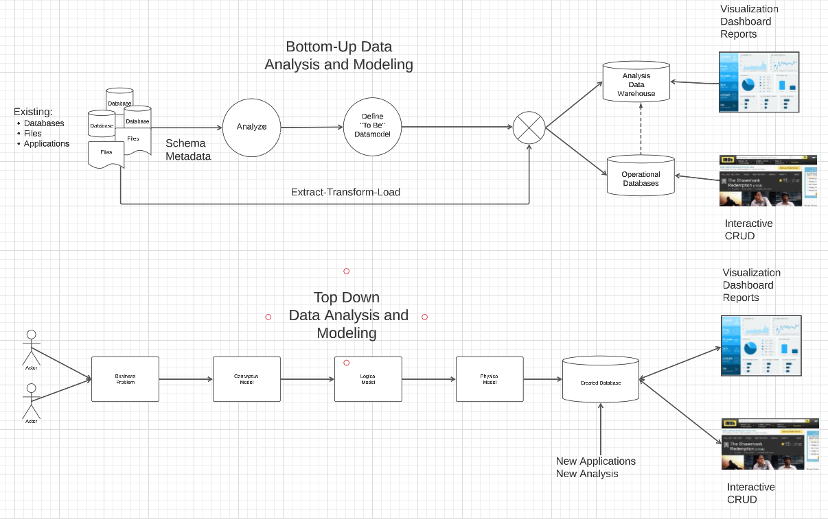
Top-Down and Bottom-Up Data Modeling
The most common is meet-in-the-middle:
Top-down defines the end state.
Bottom-up defines how to get existing info there.
Top-down development adds new apps and info.

Slide 103
Bottom-Up: Game of Thrones and IMDB
Several files from IMDB:
Titles Basics
Titles AKAS
Titles Episodes
Titles Crews
Title Principals
Title Ratings
Name Basics
Tab Separated Value
To Be Data Model and DB
Game of Thrones: (https://jeffreylancaster.github.io/game-of-thrones/)
Characters, Genders, Groups
Episodes
Locations, Opening Locations
Words: Script, Bag, ... ...
Geography
... ...
JSON

Slide 104
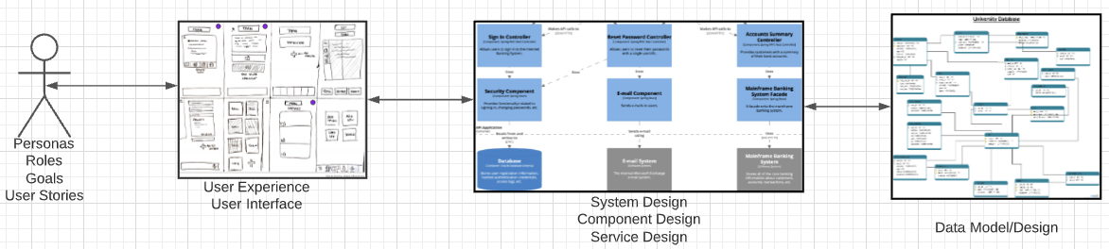
Top-Down: University Management
We must build a system that supports academic operations in a university.
There are two major domains:
Interactive operations, e.g. register, choose class, assign grade, ... ...
Insight and reporting, e.g. enrollment trends, overloaded resources, ... ...
We will design, develop, test and deploy the system iteratively and continuously.
There are four core domains.
The processes are iterative, with continuous extension and details. We will obviously focus on the data aspects in a database course.
In this course,
We focus on the data dimension.
We will get some insight into the other dimensions.

